Slide 1
Big Data – Big Data Fundamentals Week 3
Professor Arturo Castellanos, PhD
Assistant Professor – William & Mary
Big Data - MSBA

Slide 2

Week 2 – Map/Reduce Patterns
Outline
Analytics patterns
Hadoop in Docker (Friday class was on-demand. Any questions?)
Map Reduce patterns
Numerical Summarization
Top-N
Filter
Distinct
Binning
Inverted Index
Sorting
Joins
Regular Expressions
Chapter 8 - © 2019 Arshdeep Bahga & Vijay Madisetti

Slide 3
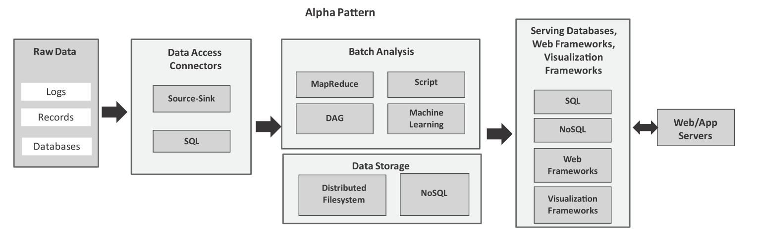
Analytics Patterns: alpha pattern
Alpha pattern
This pattern can be used for ingesting large volumes of data into a distributed ﬁlesystem (such as HDFS) or a NoSQL database (such as HBase) using source-sink connectors (such as Flume) and SQL connectors (such as Sqoop). After the data is moved to the stack, the data can be analyzed in batch mode with batch analysis frameworks including MapReduce (using Hadoop), scripting frameworks (such as Pig), distributed acyclic graph frameworks (such as Spark), machine learning frameworks (such as Spark MLlib). The analysis results are stored either in relational or non-relational databases.
Chapter 8 - © 2019 Arshdeep Bahga & Vijay Madisetti

Slide 4
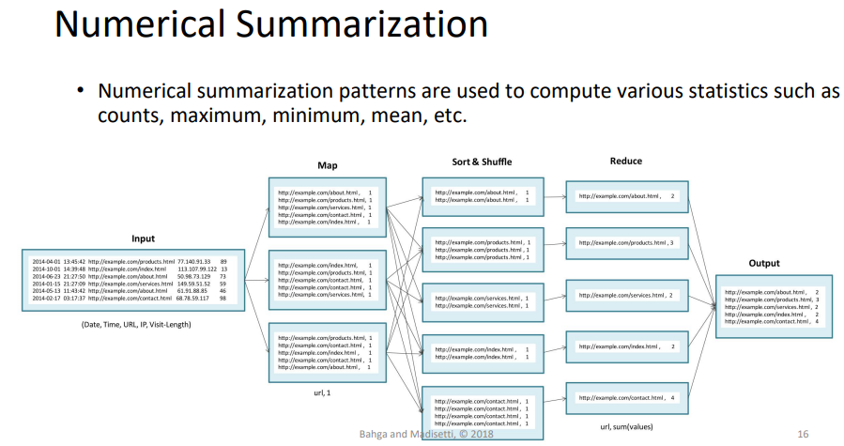

Slide 5
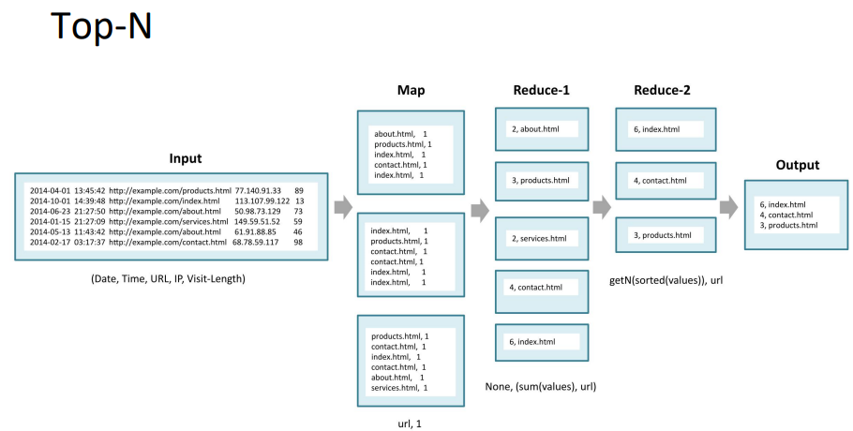

Slide 6
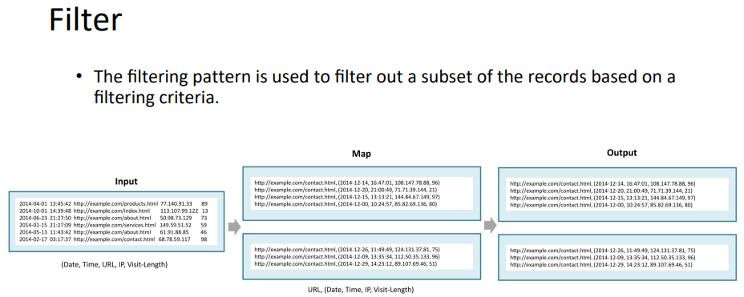

Slide 7
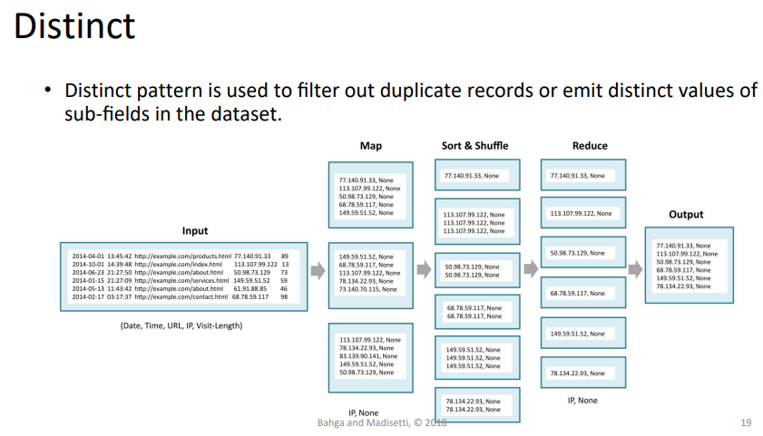

Slide 8
Jupyter – RegEX LAB Review(1/2)

Slide 9
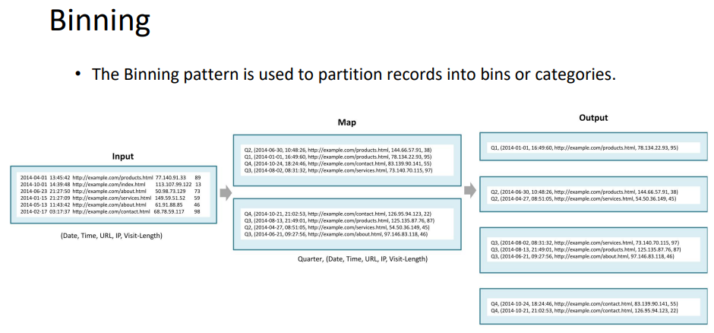

Slide 10
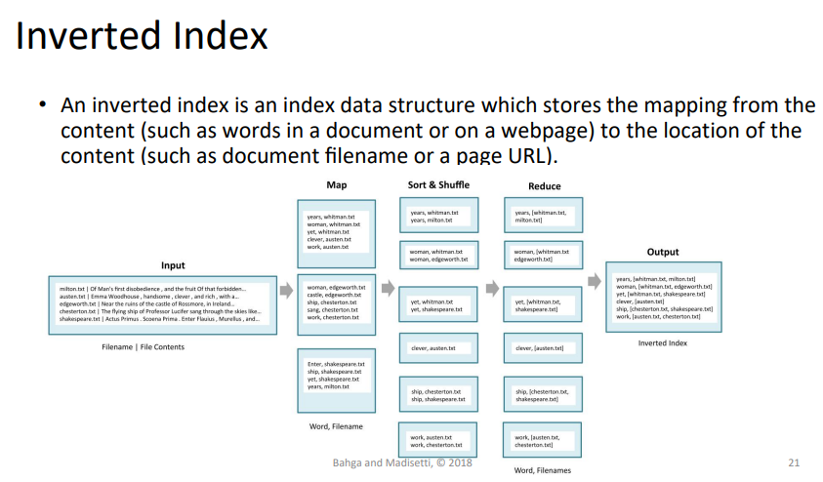

Slide 11
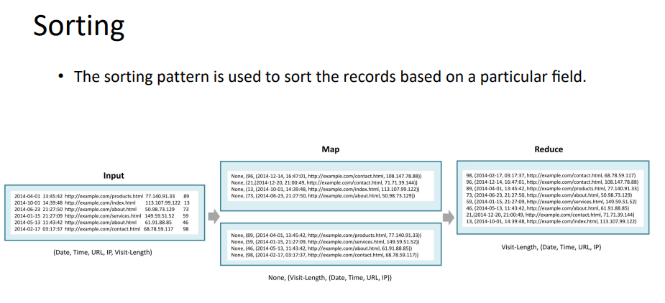

Slide 12
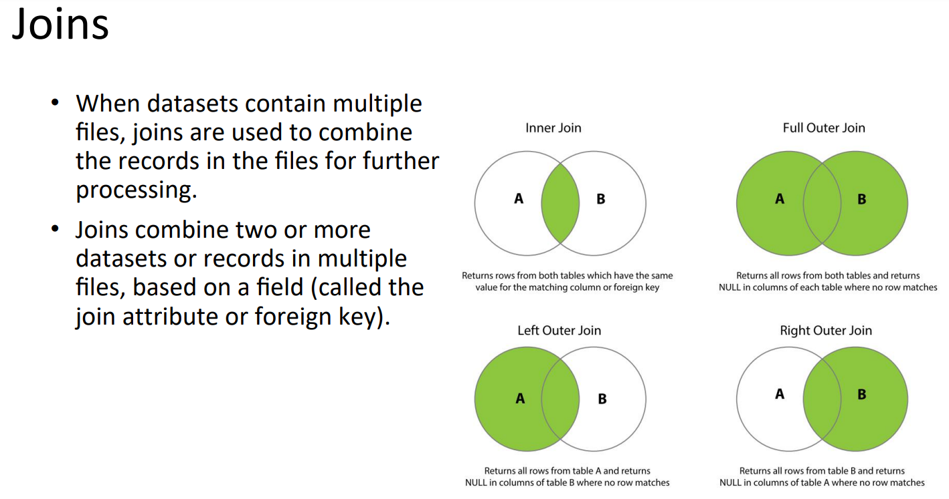

Slide 13
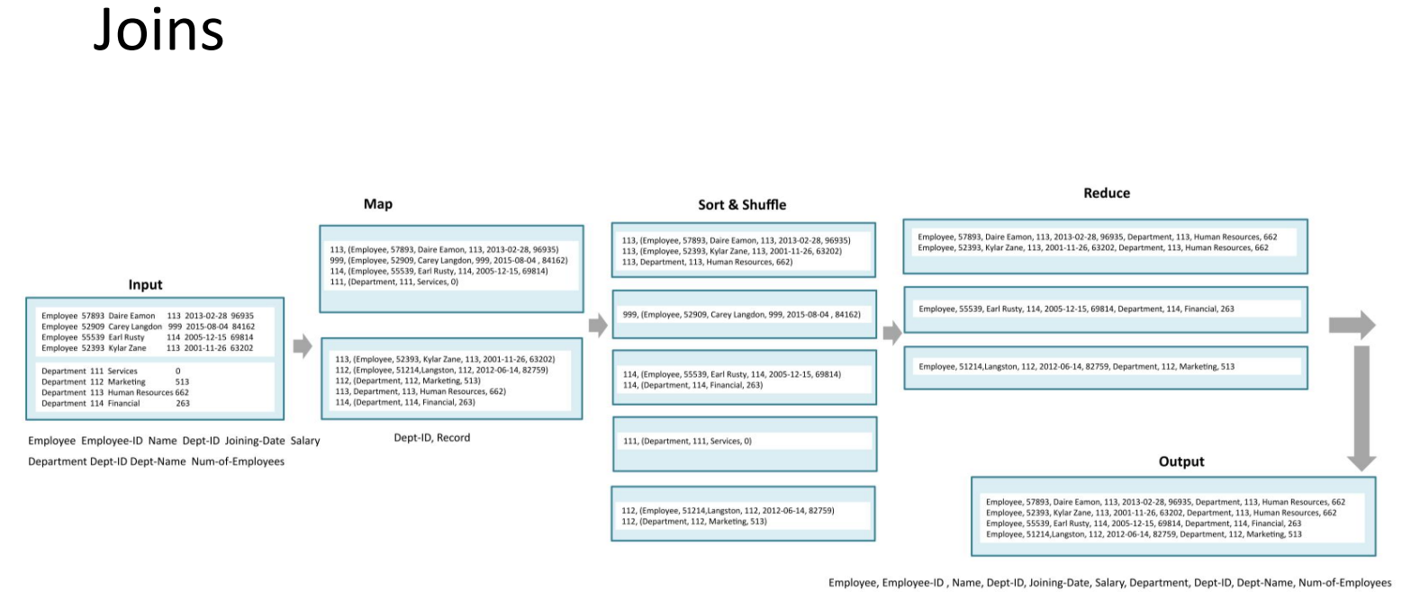

Slide 14
Jupyter – RegEX LAB Review(1/2)

Slide 15
LAB2: map/reduce Log file

